Slide 1
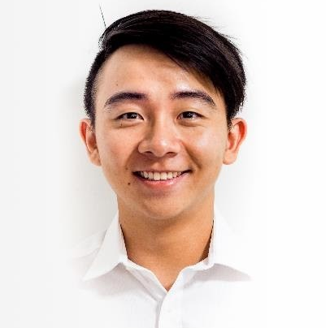


Career
Accenture (Aug 2017 - present)
Business & Technology Team Lead
Lead a cross-functional team of 6 for over 2 years with end-to-end system delivery - from design and implementation of a product backlog to architecting solutions and system enhancements for a national G2B authorisation platform that impacts a user base of over 1 million
Proficient in data-driven requirements gathering and backlog prioritisation with the client in AGILE sprints, drawing conclusions and highlighting assumptions in line with strategic roadmap
Experienced in 24/7 PROD environment resiliency through monitoring, user alerts and monthly statistical reports, maintaining SLA of 99.9% for over 300 government digital services integrated with the national G2B platform
Well-versed in incident investigation, root-cause analysis, damage control and change management, resulting in a 100% incident resolution rate of the national G2B platform
Innovated and proposed a new authentication method that leverages upon Quick Response technology and two-factor authentication, resulting in over 50% decrease in transaction time and benefitting a user base of over 4 million nationwide
Zenn Tan
Business & Technology Consultant
Education
Nanyang Technological University (2013 – 2017)
BEng Mechanical Engineering 1st Class Honours
Nanyang Scholarship CN Yang Scholars’ Programme
Qualifications
Scrum.org Professional Scrum Developer (2019)
AWS Certified Solutions Architect Associate (on track)
Singapore Armed Forces Army (Feb 2012 – Present)
Armoured Infantry Captain
Proficient in advanced Armour platoon-level operations and division HQ planning
Competencies
Leadership, project management, delivery, client management, solution architecting, requirements gathering, wireframing, testing, waterfall, Microsoft Office Suite, mySQL, DB2SQL, AWS Solutioning
Volunteering
Love Kuching Project (2016 - present)
Weekly Foster Care Shift Lead
Volunteers weekly at Love Kuching Project, a community that provides cat therapy sessions to the vulnerable and rescues and rehabilitates injured, ill or orphaned cats with the goal of adoption
Trained and taught foster care volunteers in all-round care, behavioural knowledge and medical care skills for sick, injured or orphaned felines, helping over 75 animals live a better life
tan.youngkiat.zenn@gmail.com
+65 9338 0679
Hobbies
Bouldering, sailing, scuba diving (PADI AOW)

